Slide 1
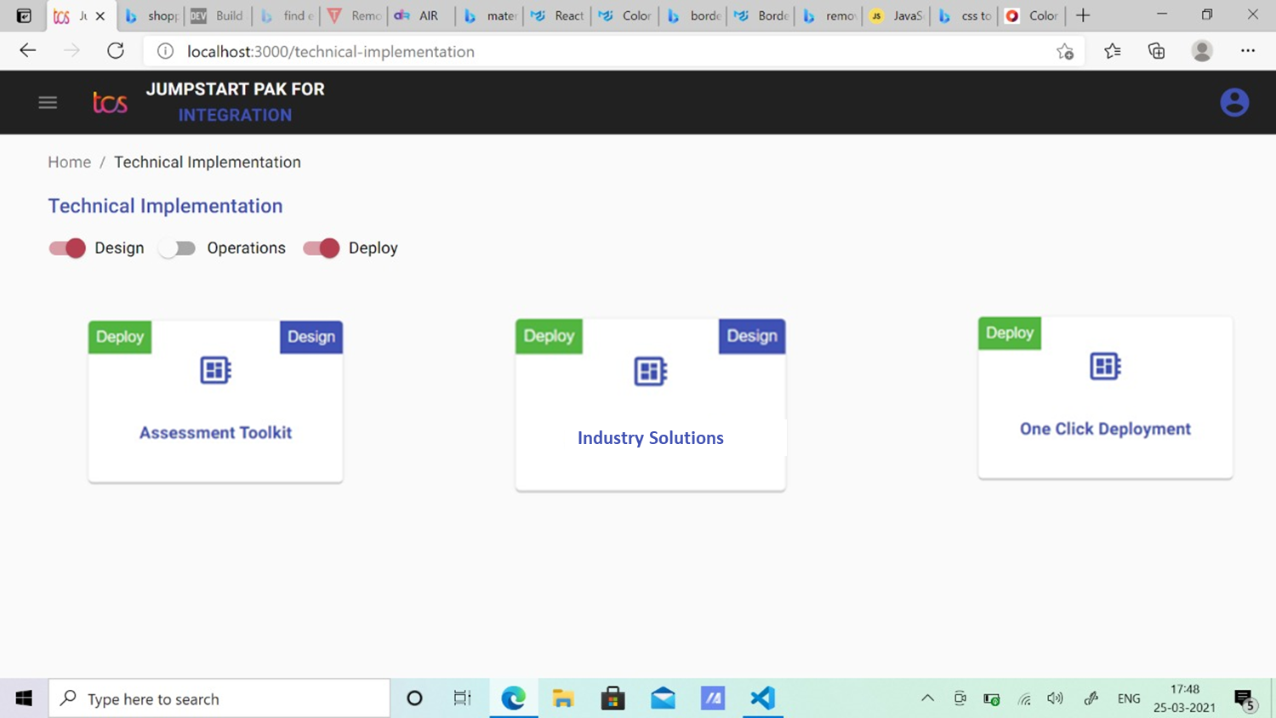
Clicking here

Slide 2
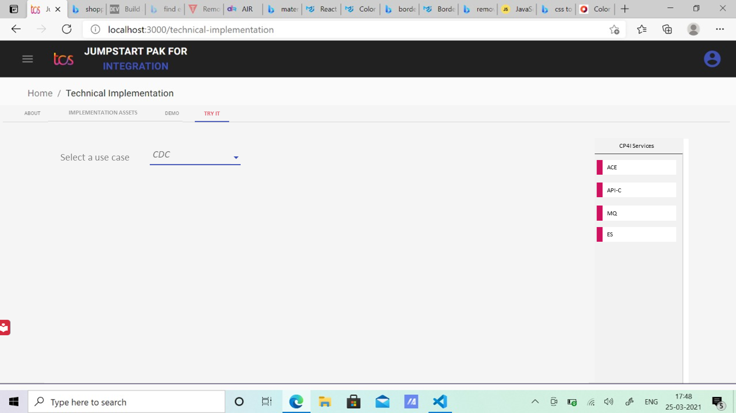

/ Industry solutions
blank
Landing page
Some content to describe what does industry solution means.

Slide 3
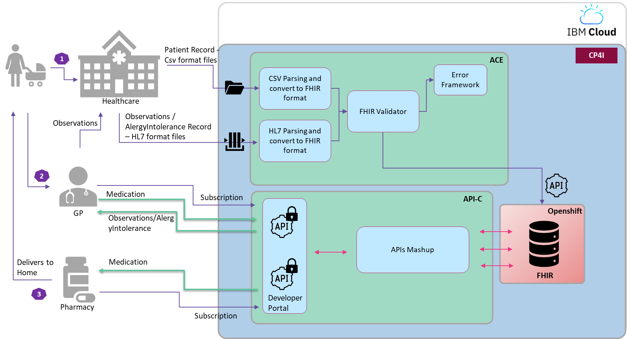
Selecting here
/ Industry solutions
Then Selecting here
FHIR
Interoperable healthcare is the future and is critical to improving clinical and operational workflows. Without an Interoperable solution, health organizations will be challenged to extract value from Clinical data to realize simpler processes, efficient care, improved experiences, and faster innovations. FHIR (Fast Healthcare Interoperability Resources), is becoming the De facto for interoperability in healthcare which describes the APIs and data formats for exchanging health information.
on any location of your choice – Private / Public cloud.

Slide 4
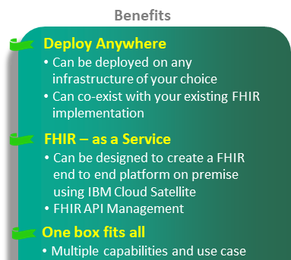
FHIR
Interoperable healthcare is the future and is critical to improving clinical and operational workflows. Without an Interoperable solution, health organizations will be challenged to extract value from Clinical data to realize simpler processes, efficient care, improved experiences, and faster innovations. FHIR (Fast Healthcare Interoperability Resources), is becoming the De facto for interoperability in healthcare which describes the APIs and data formats for exchanging health information.
Real-time data ingestion: Ingestion, Normalization and transformation of Clinical data from multiple sources into FHIR standard API. FHIR batch/transaction API is used to ingest large quantities of data from health devices, feeding Kafka and a data lake which is used for downstream analytic applications
FHIR-native operational data store: SORs, mobile applications use the FHIR HTTP API to store and retrieve FHIR resources in IBM DB2.
API-Market Place: Manage APIs with full set of API Management capabilities on any location of your choice – Private / Public cloud.
Scroll down for more contents

Slide 5
Clicking on Try it should show below tiles
FHIR
Patient
GP
Pharmacy

Slide 6
Click on patient
FHIR
Patient
GP
Pharmacy

Slide 7
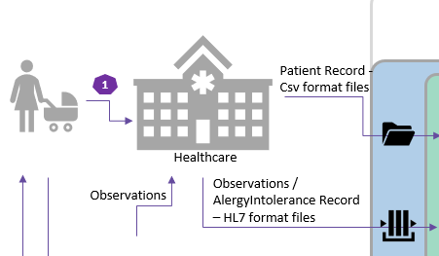
FHIR
Patient
Create/Update Patient record CSV
Create/Update Observation/Allergy HL7
back

Slide 8
Click on GP or Pharmacy Should take to respective portal
FHIR
Patient
GP
Pharmacy

